Slide 1





The First Student Journal Club
On AIM 2022
Deep Learning and Machine Learning Approaches to Disease Data
Presented by
Mohammad Hasannejad
Shiraz Medical School
Department of medical physics, engineering and artificial intelligence

Slide 2
Different fields
Brain
Cancer
Alzheimer
Parkinson
Cardio Vascular
Skin
Cancer
Epidemic
Covid-19
Malaria
Influenza like diseases

Slide 3
Brain related diseases
Diagnosis
Prediction
Classification

Slide 4

Diagnosis
Precise and accurate diagnosis == patient will live more

Slide 5
We need more data to increase accuracy of models
The use of hybrid algorithms and a combination of supervised with unsupervised and ML with DL methods are promising to provide better results.
To design effective AI systems for medical applications, the inclusion of XAI approaches is the ultimate necessity.

Slide 6
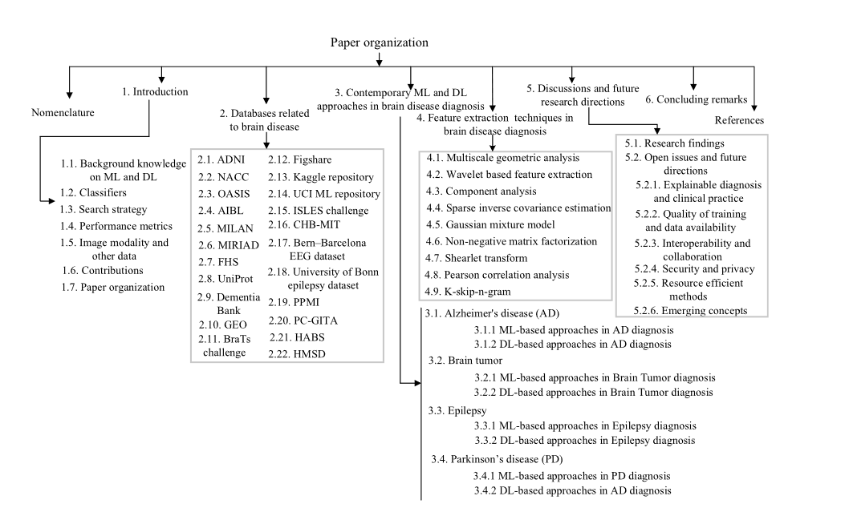

Slide 7
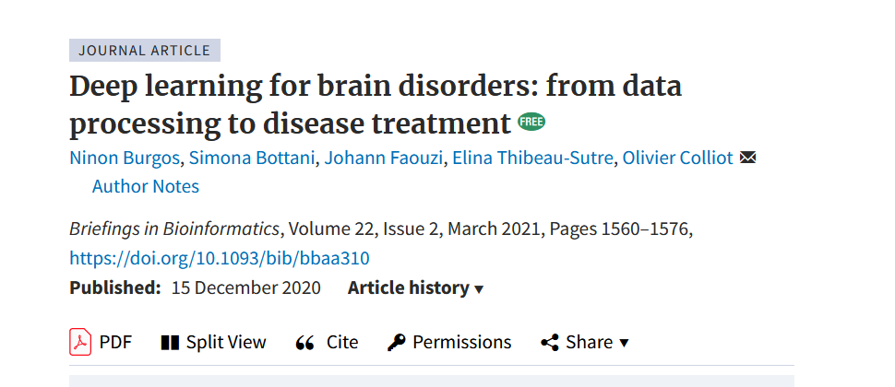

Slide 8
CNNs have been successfully applied to imaging and genetic data in numerous brain disorders, while recurrent neural networks showed encouraging results with longitudinal clinical data and sensor data. Many tasks, such as cross-modality image synthesis, image segmentation, disease diagnosis and outcome prediction, have been substantially improved thanks to DL.

Slide 9
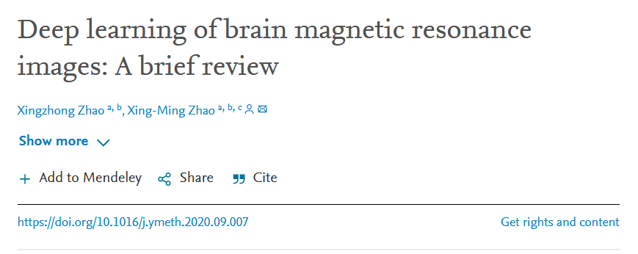

Slide 10
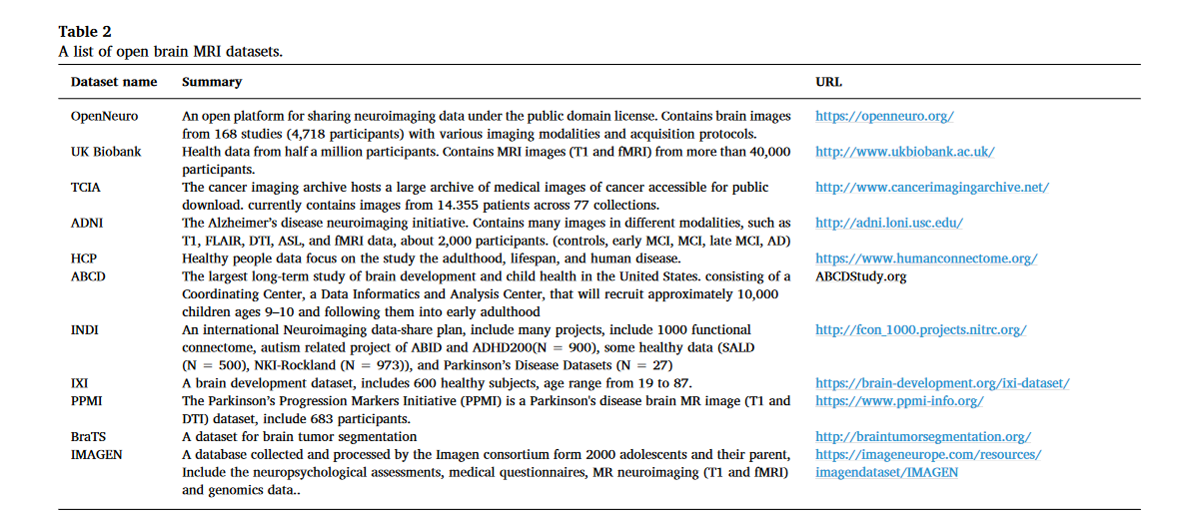
MRI Datasets

Slide 11
DL for computer aided diagnosis
Lesion detection
Neurodegenerative disorders
Schizophrenia
Alzheimer
Parkinson

Slide 12
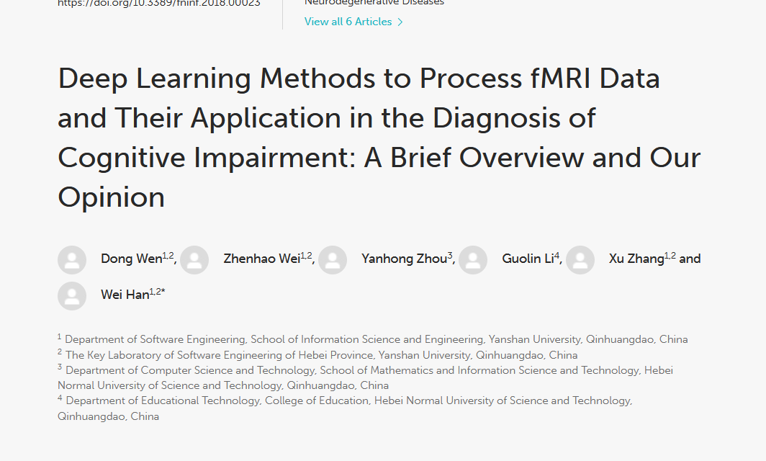

Slide 13
CNN
CNN was used to effectively classify fMRI data and to classify and diagnose Alzheimer's disease (AD) and aMCI The CNN method consists of the following three applications: feature extraction, construction of auto-encoder and construction of 3-Dimensional Convolutional Neural Networks (3D-CNN) method
https://towardsdatascience.com/a-comprehensive-guide-to-convolutional-neural-networks-the-eli5-way-3bd2b1164a53
https://victorzhou.com/blog/keras-cnn-tutorial/
https://ecode.dev/cnn-for-medical-imaging-using-tensorflow-2/

Slide 14
Feature Extraction
To predict the lifetime of patients with brain tumors, CNN was used to extract features from fMRI data with the Support Vector Machine used for classification (Nie et al., 2016). Indeed, the study can use CNN to extract valid features, but whether the resulting features are redundant or not remains to be tested. In addition, the extracted features correspond to what features of the brain have yet to be explored

Slide 15
What is Feature Extraction
https://towardsdatascience.com/feature-extraction-techniques-d619b56e31be
Feature Extraction aims to reduce the number of features in a dataset by creating new features from the existing ones (and then discarding the original features).

Slide 16
3D-CNN
The data from Human Connectome project (HCP) was utilized to reconstruct the brain network with a higher accuracy
A 3D CNN is simply the 3D equivalent: it takes as input a 3D volume or a sequence of 2D frames (e.g. slices in a CT scan), 3D CNNs are a powerful model for learning representations for volumetric data.
http://www.humanconnectomeproject.org/
https://www.humanconnectome.org/

Slide 17
FNN
Not as good as CNN , not even good , why? Cause its unable to work with high dimensional data

Slide 18
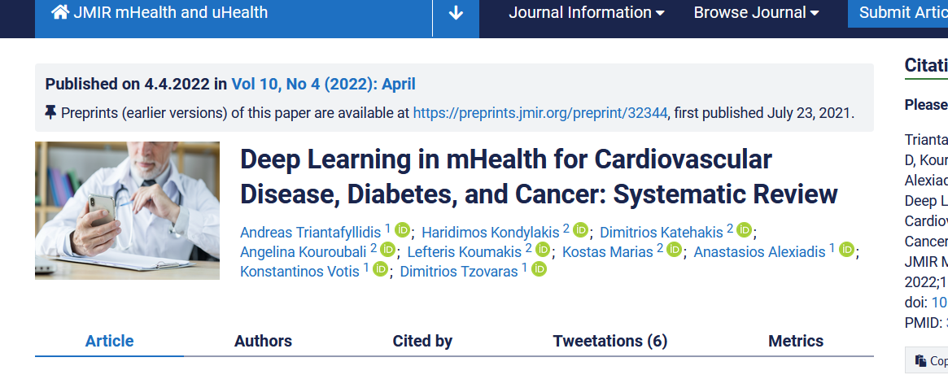

Slide 19
The most common DL outcome was the diagnosis of the patient’s condition for the CVD studies, prediction of blood glucose levels for the studies in diabetes, and early detection of cancer.
Most of the DL algorithms used were convolutional neural networks in studies on CVD and cancer and recurrent neural networks in studies on diabetes.
Performance of DL was satisfactory reaching > 84% accuracy in most studies.

Slide 20
RNN
A recurrent neural network (RNN) is a type of artificial neural network which uses sequential data or time series data.
https://www.ibm.com/cloud/learn/recurrent-neural-networks

Slide 21
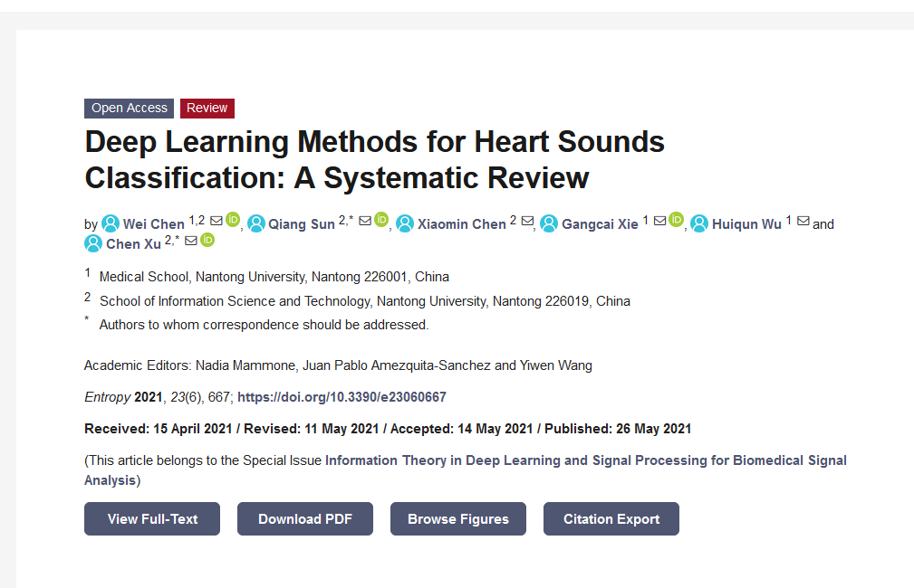

Slide 22
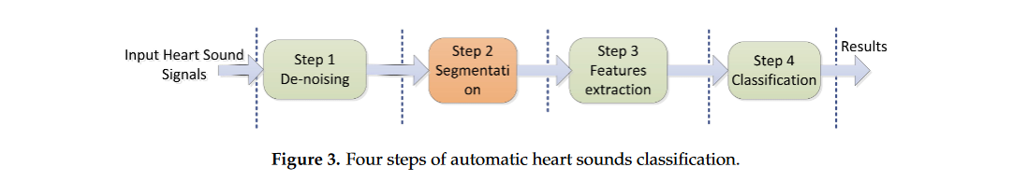

Slide 23
Ml methods:
Gaussian mixture models, random forests, support vector machines (SVMs), and hidden Markov models (HMMs)
DL methods:
deep CNNs and RNNs

Slide 24
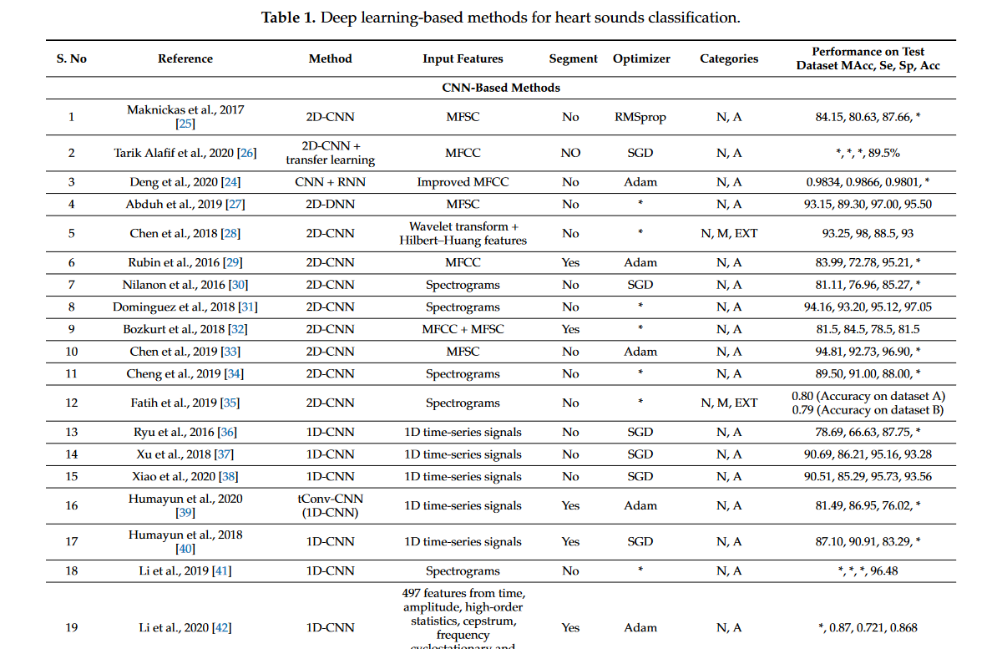

Slide 25
Cardiovascular dataset types
Demographics
ECG
Genome
PET imaging
sound

Slide 26
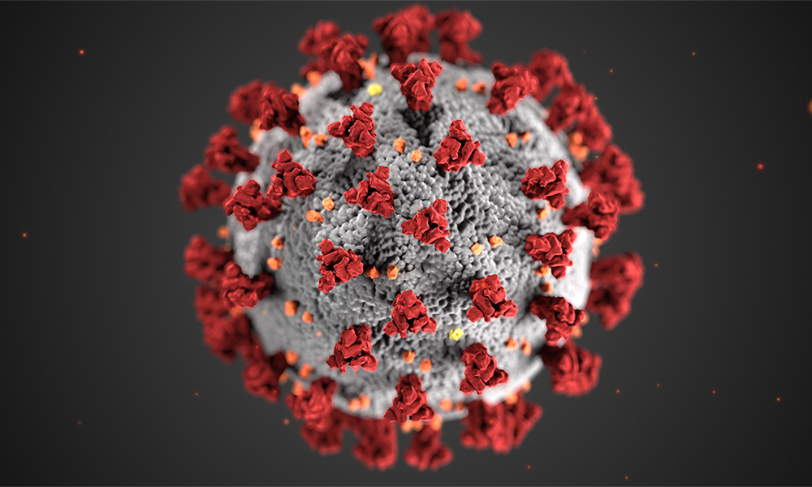
Deep learning for epidemic and pandemic diseases

Slide 27
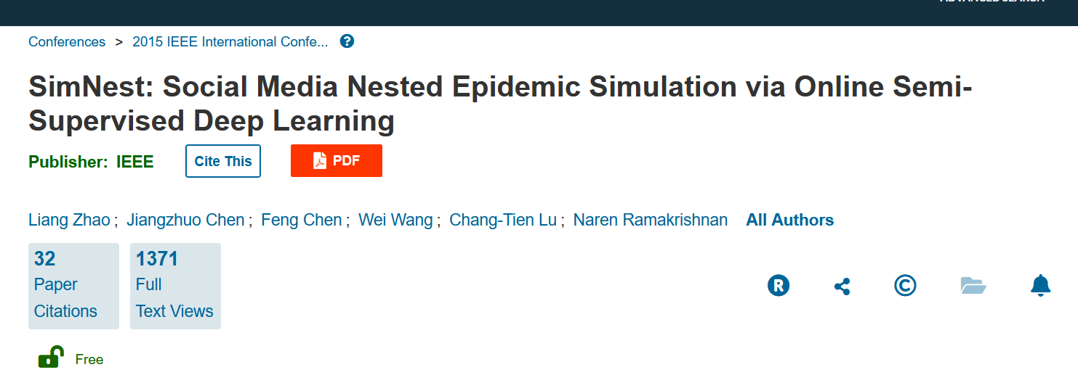

Slide 28
integrates the strengths of artificial neural networks and causal methods.

Slide 29
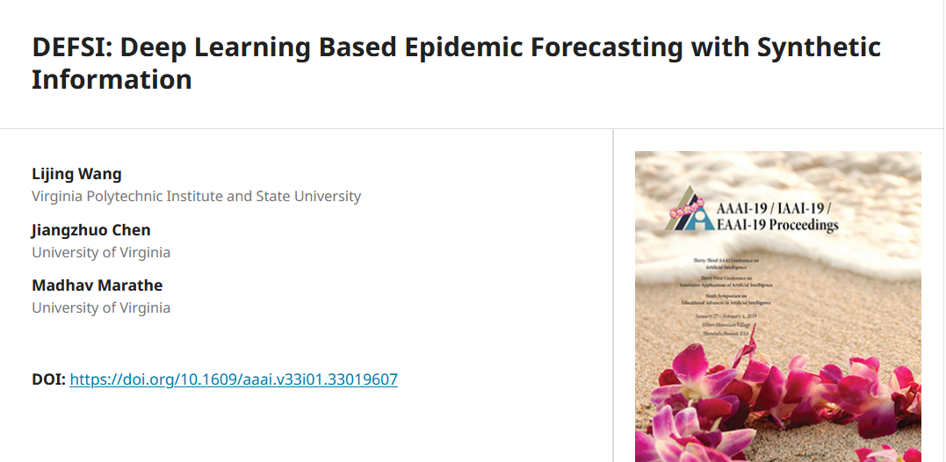

Slide 30
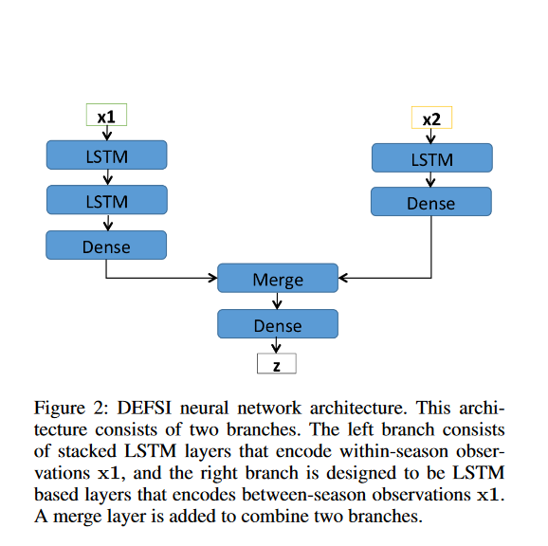

Slide 31
integrates the strengths of deep neural networks and high-resolution simulations of epidemic processes over networks. TDEFSI yields accurate high-resolution spatiotemporal forecasts using low-resolution time-series data.
The resulting forecasts are not just driven by observed data but also capture the intricate social, demographic, and geographic attributes of specific urban regions and mathematical theories of disease propagation over networks.

Slide 32
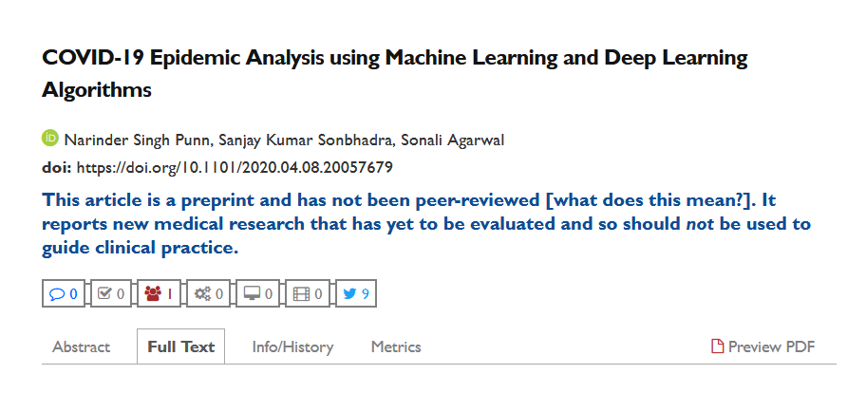

Slide 33
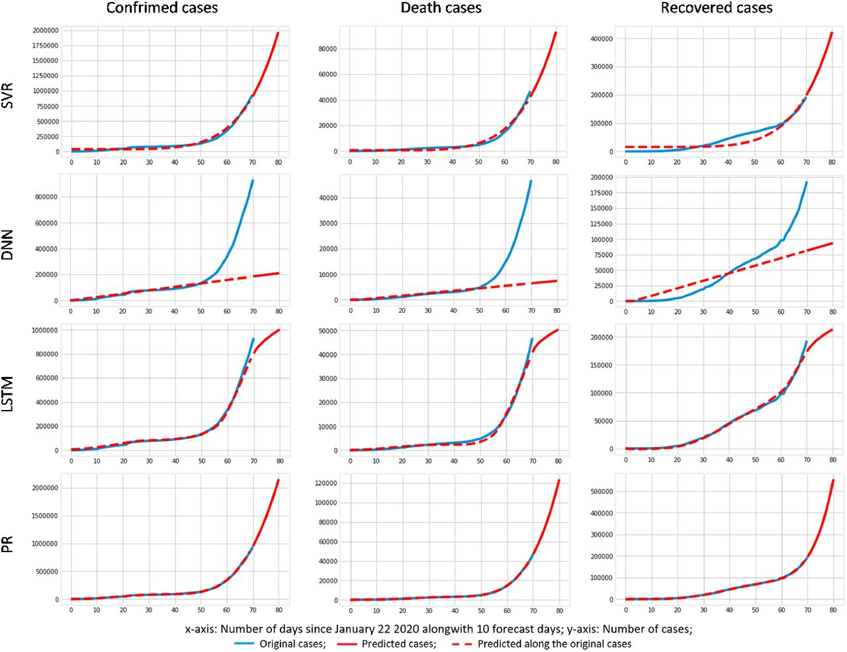
Models used
SVR
polynomial regression
DNN
LSTM

Slide 34
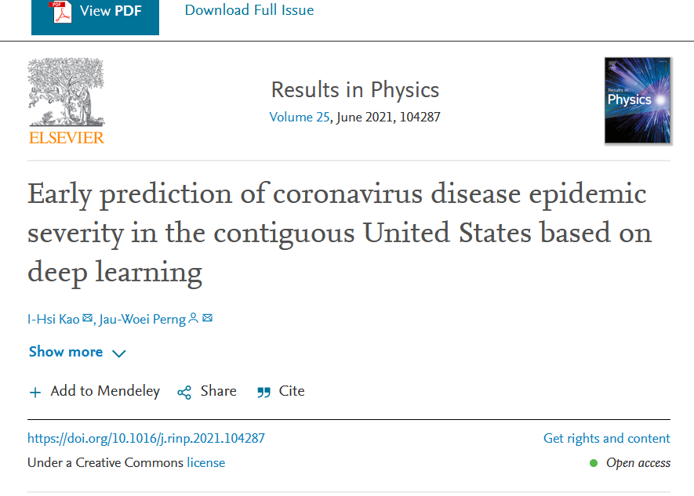

Slide 35
using CAE and AL-CNN models. The CAE is a deep learning neural network connected by a series of CNNs. Although CAE has a good predictive ability, there remains a lack of a design framework for time-series data in neural networks. The AL-CNN is a modified version of the CAE that adds an LSTM between the encoder and decoder to increase the processing power of the model for time series data

Slide 36
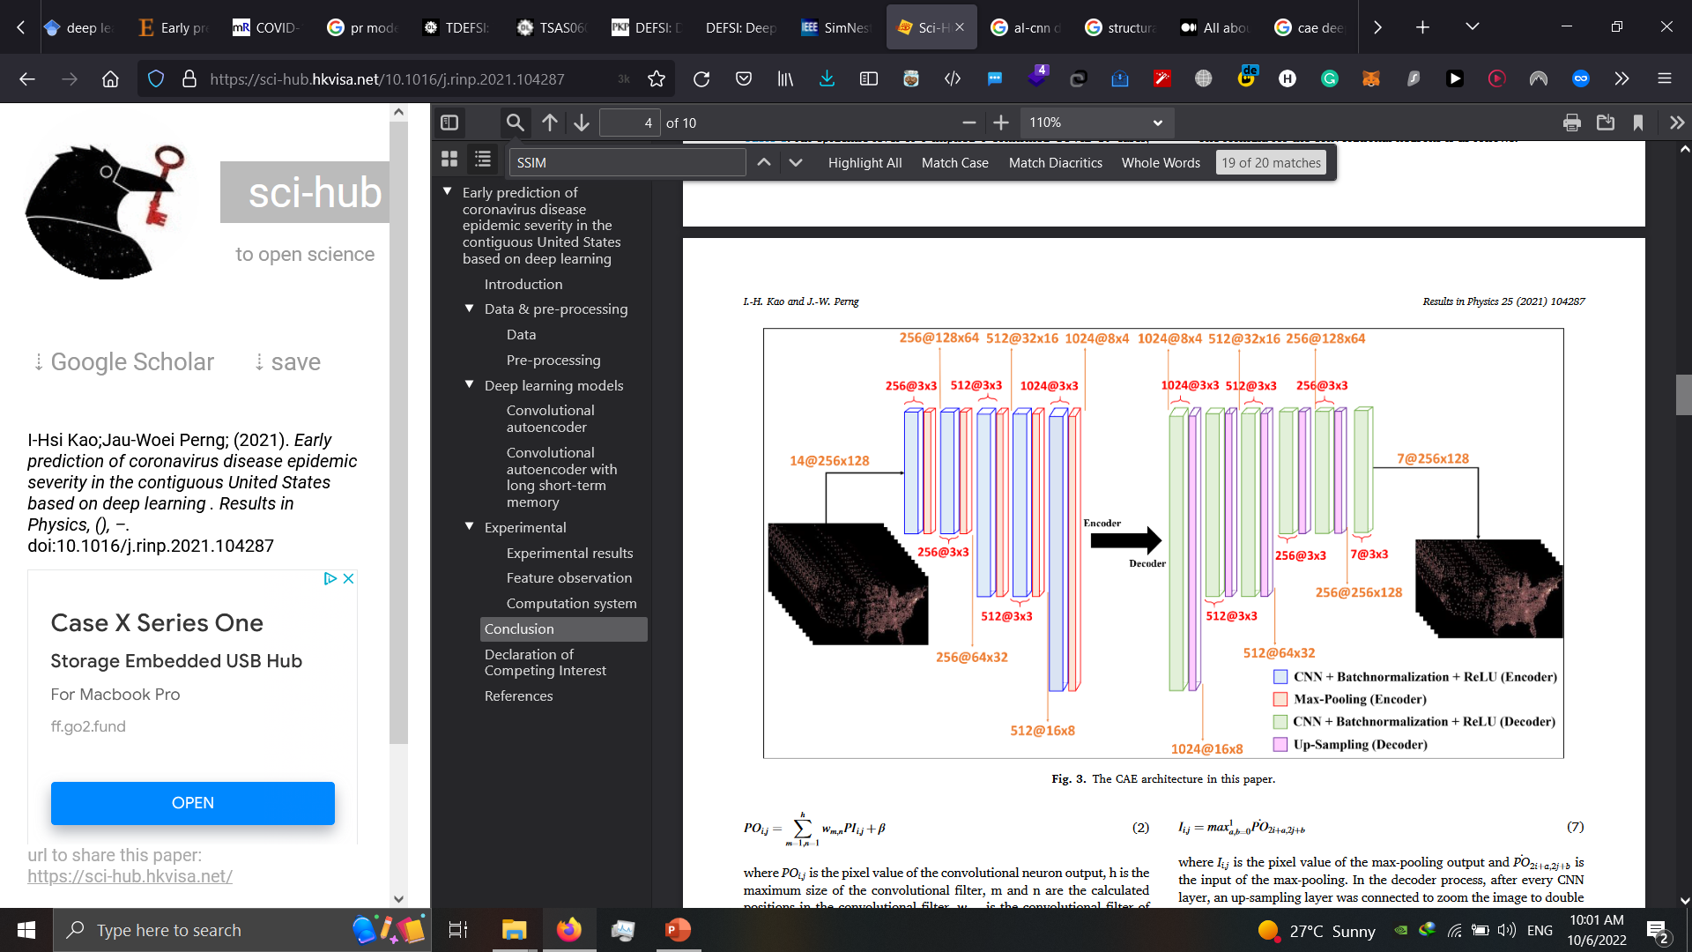
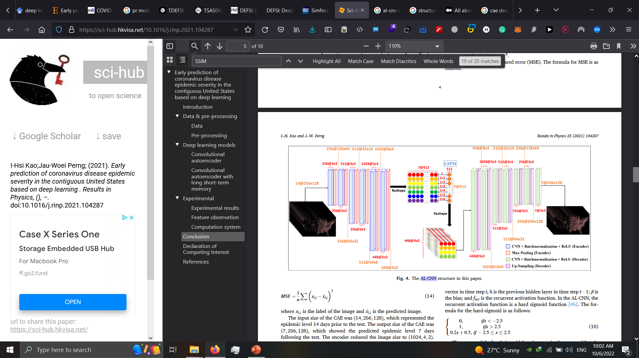

Slide 37
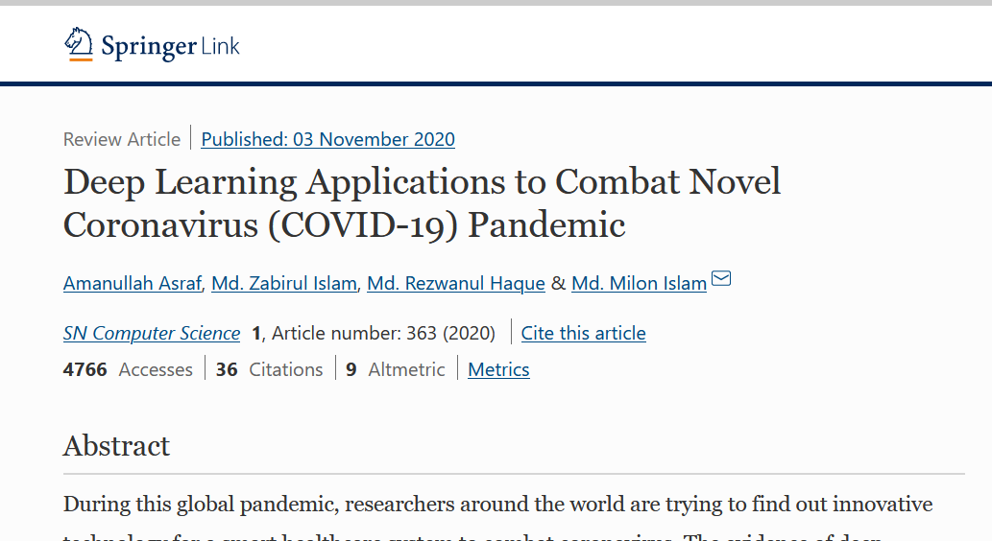

Slide 38
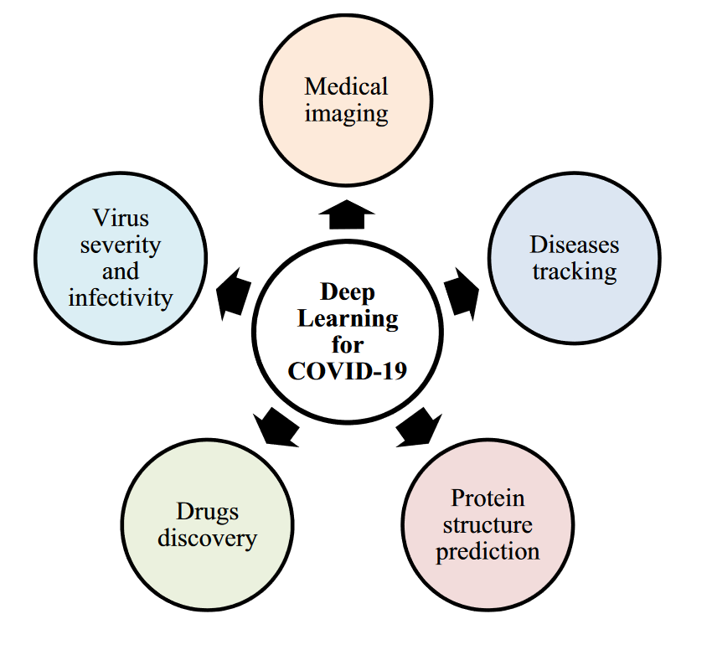

Slide 39
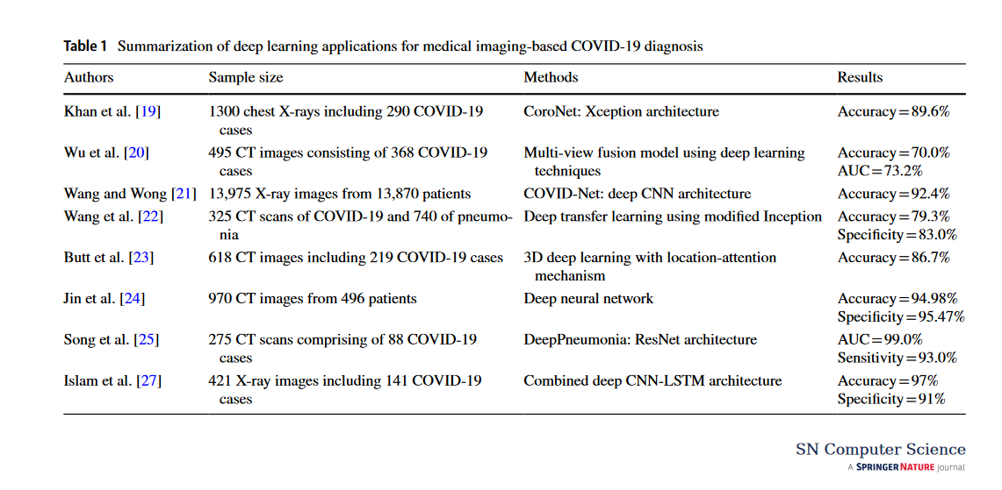

Slide 40
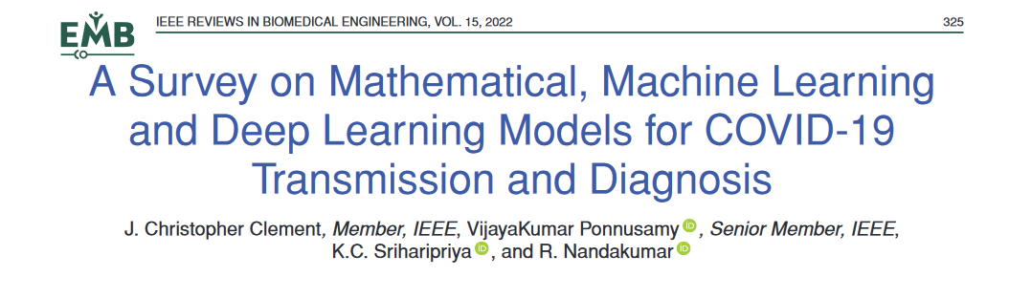

Slide 41
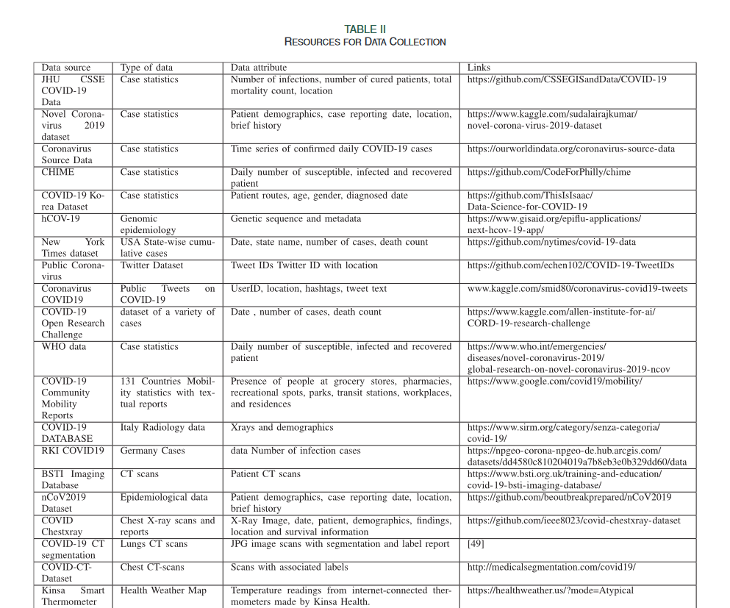

Slide 42
